Slide 1




Brokered Agreements in Multi-Party Machine Learning
10th ACM SIGOPS Asia-Pacific Workshop on Systems (APSys 2019)
Clement Fung, Ivan Beschastnikh University of British Columbia

Slide 2
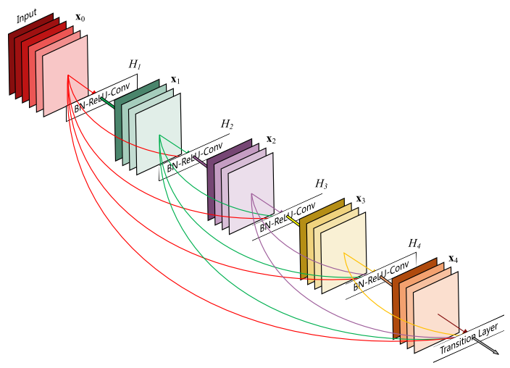

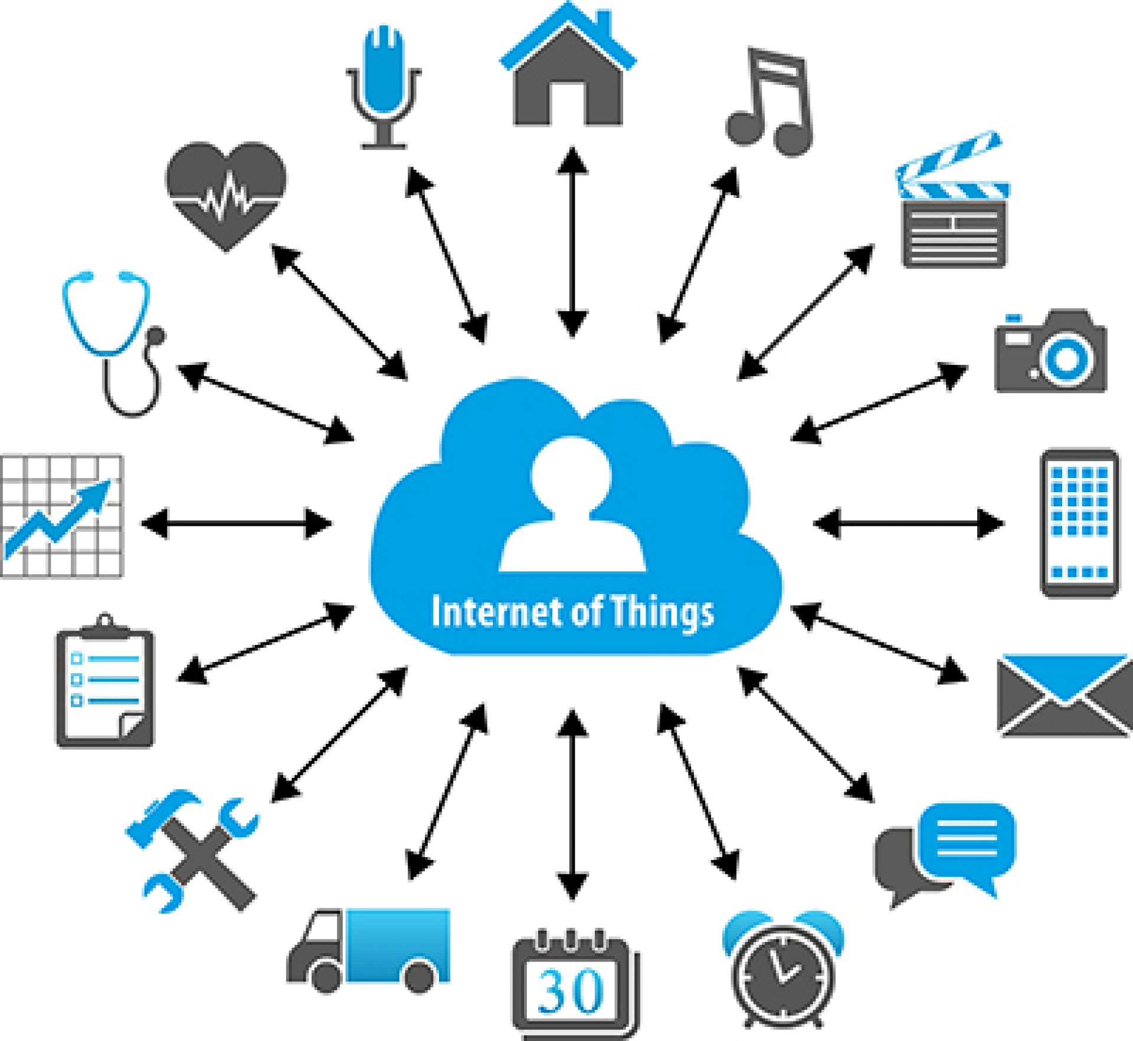
The emerging ML economy
With the explosion of machine learning (ML), data is the new currency!
Good quality data is vital to the health of ML ecosystems
Improve models with more data from more sources!

Slide 3


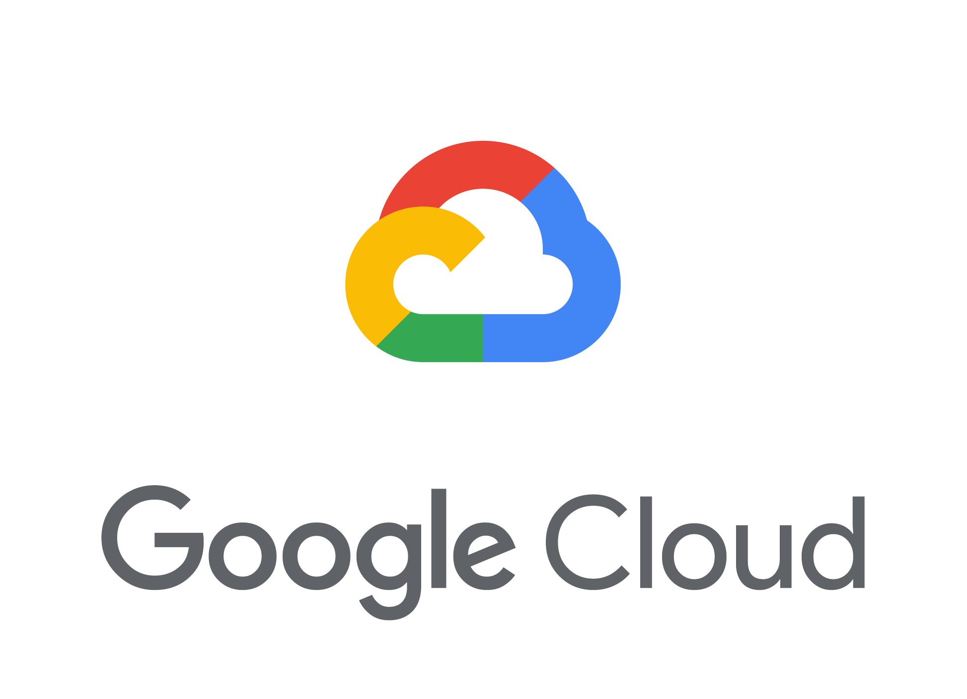

Actors in the ML economy
Data providers:
Owners of potentially private datasets
Contribute data to the ML process
Model owners:
Define model task and goals
Deploy and profit from trained model
Infrastructure providers:
Host training process and model
Expose APIs for training and prediction

Slide 4
Actors in today’s ML economy
Data providers supply data for model owners
Model owners:
Manage infrastructure to host computation
Provide privacy and security for data providers
Use the model for profit once training is complete
Information Transfer

Slide 5
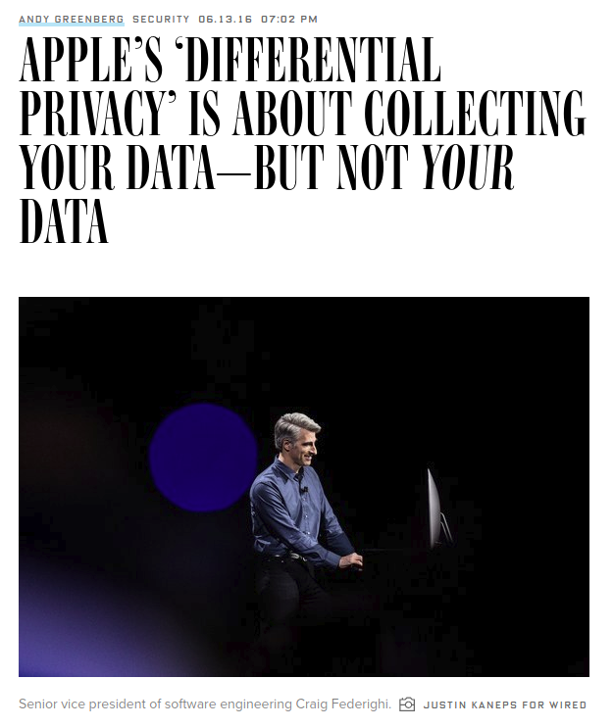
In-House privacy solutions
[1] Wired 2016. [2] Apple. “Learning with Privacy at Scale” Apple Machine Learning Journal V1.8 2017. [3] Wired 2017.

Slide 6

In-House privacy solutions
[1] Wired 2016. [2] Apple. “Learning with Privacy at Scale” Apple Machine Learning Journal V1.8 2017. [3] Wired 2017.

Slide 7
Incentive trade-off in the ML economy
Not only correctness, but there is an issue with incentives:
Data providers want to keep their data as private as possible
Model owners want to extract as much value from the data as possible
Service providers lack incentives to provide fairness [1]
Need solutions that can work without cooperation from the system provider and are deployed from outside the system itself
[1] Overdorf et al. “Questioning the assumptions behind fairness solutions.” NeurIPS 2018.

Slide 8
Incentive trade-off in the ML economy
Not only correctness, but there is an issue with incentives:
Data providers want to keep their data as private as possible
Model owners want to extract as much value from the data as possible
Service providers lack incentives to provide fairness [1]
Need solutions that can work without cooperation from the system provider and are deployed from outside the system itself
We cannot trust model owners to control the ML incentive tradeoff!
[1] Overdorf et al. “Questioning the assumptions behind fairness solutions.” NeurIPS 2018.

Slide 9
Incentives in today’s ML economy
Data providers supply data for model owners
Model owners:
Manage infrastructure to host computation
Provide privacy and security for data providers
Use the model for profit once training is complete
Information Transfer

Slide 10
Incentives in today’s ML economy
Data providers supply data for model owners
Model owners have incentive to:
Manage infrastructure to host computation
Provide privacy and security for data providers
Use the model for profit once training is complete
Information Transfer

Slide 11

Our contribution: Brokered learning
Introduce a broker as a neutral infrastructure provider:
Manage infrastructure to host ML computation
Provide privacy and security for data providers and model owners
Information Transfer
Brokered
Agreement
Information Transfer
Broker
Notes:
Show that it’s our work

Slide 12
Federated learning
A recent push for privacy-preserving multi-party ML [1]:
Send model updates over network
Aggregate updates across multiple clients
Client-side differential privacy [2]
Better speed, no data transfer
State of the art in multi-party ML
Brokered learning builds on federated learning
Model M
𝚫M
𝚫M
𝚫M
[1] McMahan et al. “Communication-Efficient Learning of Deep Networks from Decentralized Data” AISTATS 2017.
[2] Geyer et al. “Differentially Private Federated Learning: A Client Level Perspective” NIPS 2017.
Notes:
But this doesn’t provide any privacy

Slide 13
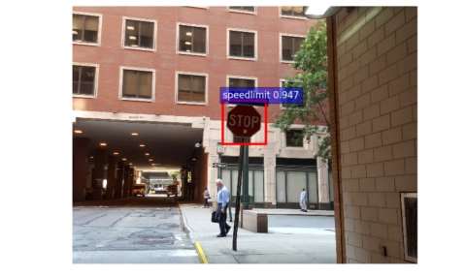
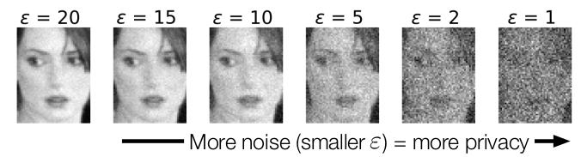
Data providers are not to be trusted
Giving data providers unmonitored control over compute:
Providers can maximize privacy, give zero utility or attack system
Providers can attack ML model, compromising integrity [1]
Providers can attack other providers, compromising privacy [2]
[1] Bagdasaryan et al. “How To Backdoor Federated Learning” arXiv 2018.
[2] Hitaj et al. “Deep Models Under the GAN: Information Leakage from Collaborative Deep Learning” CCS 2017.

Slide 14
Data providers are not to be trusted
Giving data providers unmonitored control over compute:
Providers can maximize privacy, give zero utility or attack system
Providers can attack ML model, compromising integrity [1]
Providers can attack other providers, compromising privacy [2]
We also cannot trust data providers to control the ML incentive tradeoff!
[1] Bagdasaryan et al. “How To Backdoor Federated Learning” arXiv 2018.
[2] Hitaj et al. “Deep Models Under the GAN: Information Leakage from Collaborative Deep Learning” CCS 2017.

Slide 15
Putting it all together
The state of the art in multi-party ML
Gives too much control to model owners
Not privacy focused and vulnerable
State of the art in private multi-party ML (federated learning)
Require trust in model owners or data providers
But there is no incentive for either to do so
Data marketplaces (blockchains) [1]
Security and system overkill
Much too slow for modern use cases
[1] Hynes et al. “A Demonstration of Sterling: A Privacy-Preserving Data Marketplace” VLDB 2018.

Slide 16
Putting it all together
More Centralized Less Private/Secure
Less Centralized More Private/Secure

Slide 17

Putting it all together
Centralized Parameter Server
More Centralized Less Private/Secure
Less Centralized More Private/Secure

Slide 18
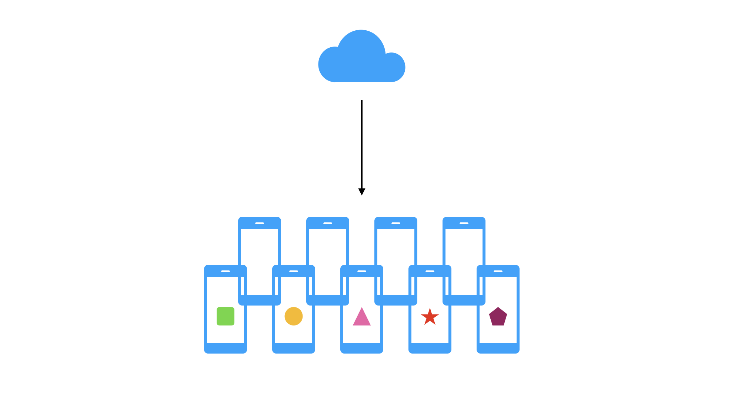
Putting it all together
Centralized Parameter Server
Federated Learning
More Centralized Less Private/Secure
Less Centralized More Private/Secure

Slide 19
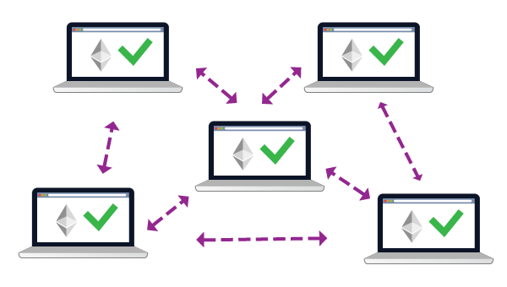
Putting it all together
Centralized Parameter Server
Federated Learning
Blockchain-based Multi-party ML
More Centralized Less Private/Secure
Less Centralized More Private/Secure

Slide 20
Putting it all together
Centralized Parameter Server
Federated Learning
Brokered Learning
Blockchain-based Multi-party ML
More Centralized Less Private/Secure
Less Centralized More Private/Secure

Slide 21
Our contributions
Current multi-party ML systems use unsophisticated threat/incentive model:
Trust the model owner
New brokered learning setting for privacy-preserving ML
New defences against known ML attacks for this setting
TorMentor: A brokered learning example of an anonymous ML system
Brokered Learning: A new standard for incentives in secure ML

Slide 22
Brokered Learning

Slide 23
Brokered agreements in the ML economy
Federated learning:
Communicate with model owner
Trust that model owner is not malicious
Model owners have full control over model and process
Brokered learning
Communicate with neutral broker
Broker executes model owner’s validation services
Decouple model owners and infrastructure

Slide 24
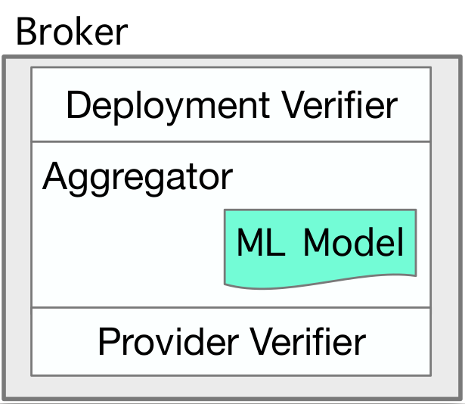
Brokered learning components
Deployment verifier
Interface for model owners (“curators”)
Provider verifier
Interface for data providers
Aggregator
Host ML deployments
Collect and aggregate model updates
Same as federated learning

Slide 25
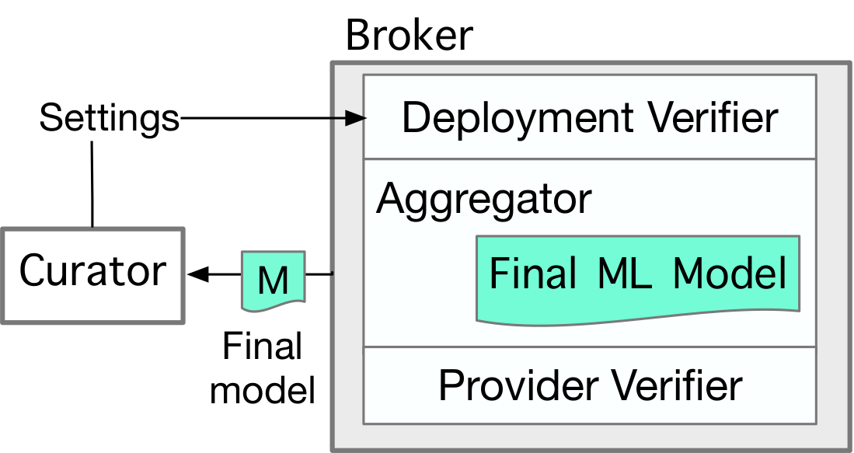
Deployment verifier API
Serves as model owner interface
curate(): Launch curator deployment
Set provider verifier parameters
fetch(): Access to model once trained
Protects the ML model from abuse from curator during training
E.g. Blockchain smart contracts [1]
[1] Szabo, Nick. “Formalizing and Securing Relationships on Public Networks” 1997.
Notes:
Szabo. 1997. Formalizing and Securing Relationships on Public Networks.

Slide 26
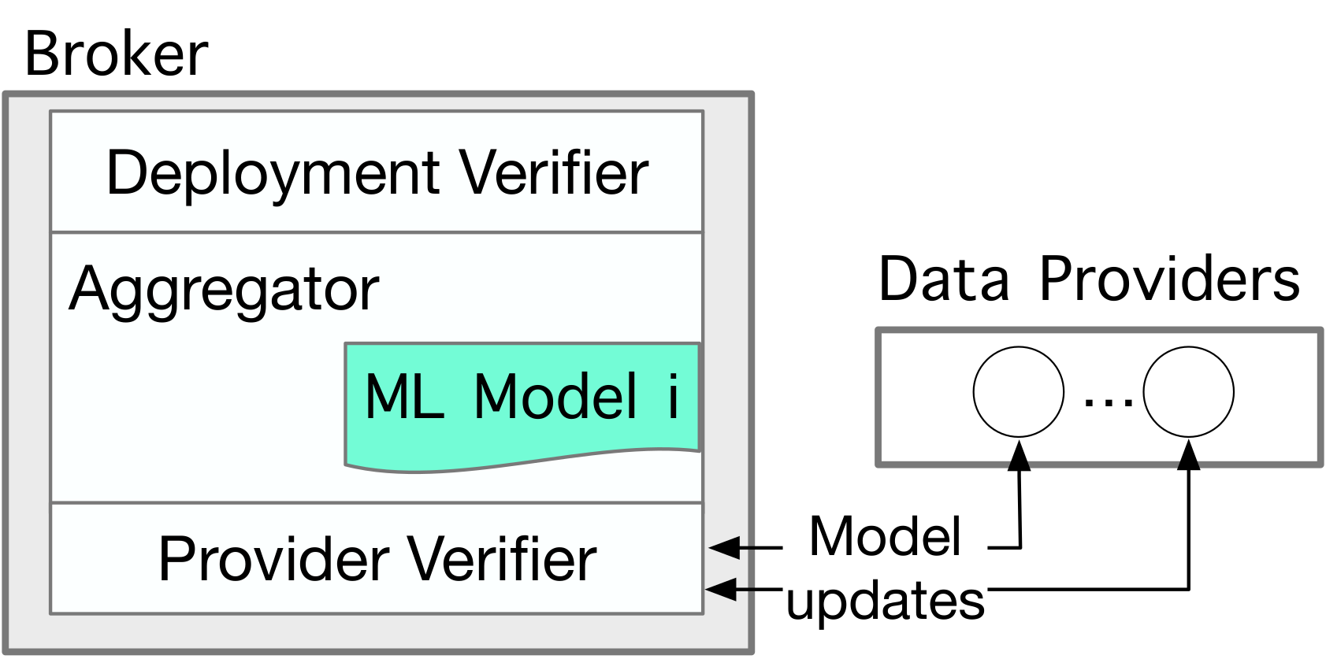
Provider verifier API
Serves as data provider interface
Defined by curator
join(): Verify identity and allow provider join
update(): Verify and allow model update
Protect model from malicious data providers
E.g. Access tokens and statistical tests

Slide 27
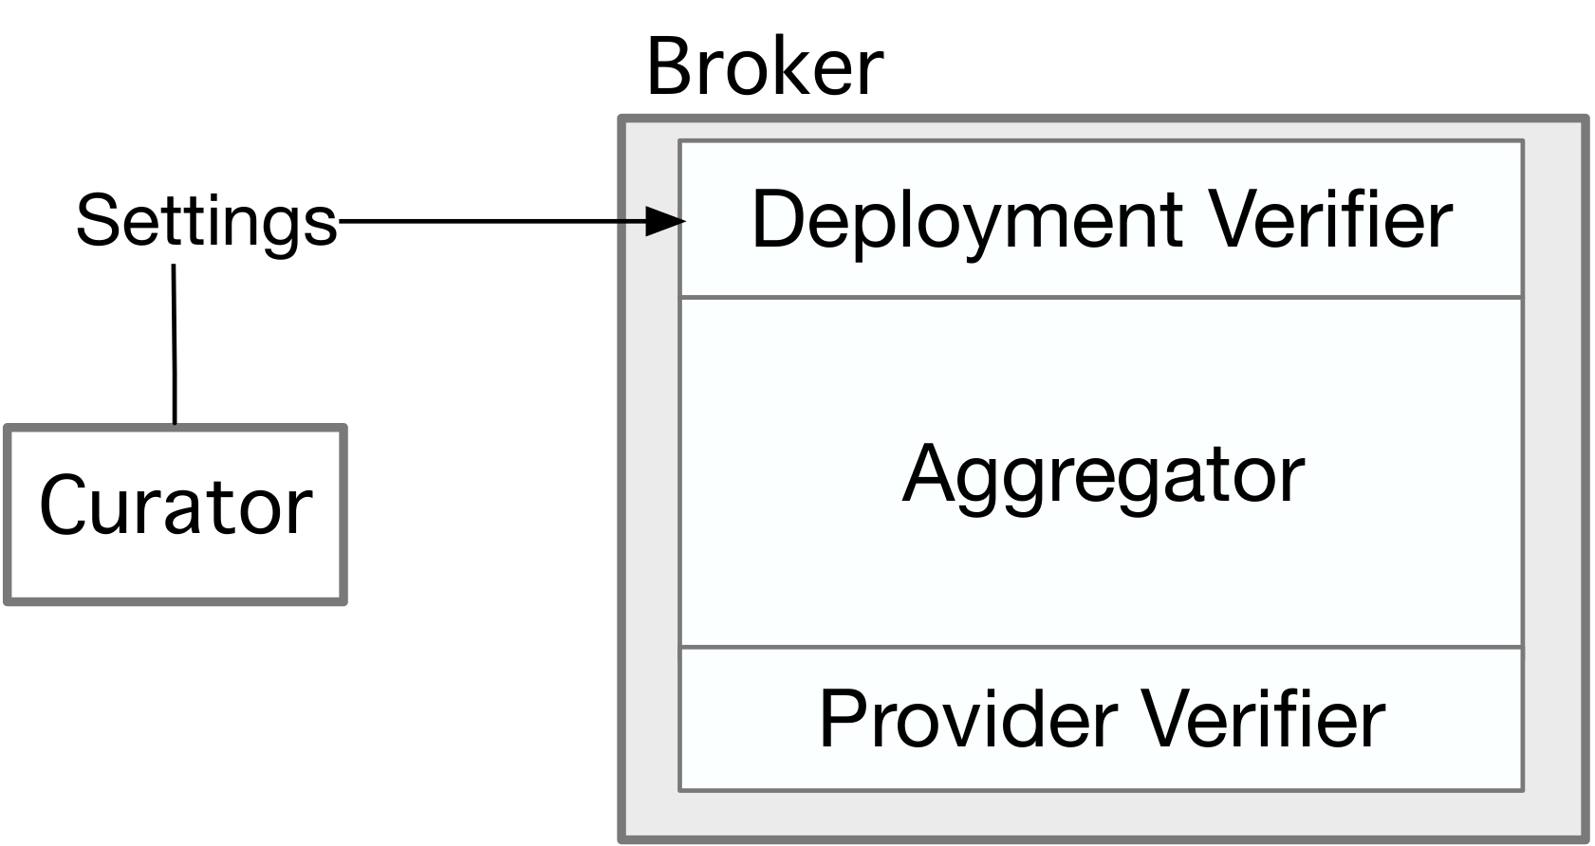
Brokered learning workflow
Curator: Create deployment
Define model and provide deployment parameters
Define verification services
Notes:
But this doesn’t provide any privacy

Slide 28
Brokered learning workflow
Curator: Create deployment
Define model and provide deployment parameters
Define verification services
Data providers: Join model
Define personal privacy preferences (ε)
Pass verification on join
Admission Parameters
Notes:
But this doesn’t provide any privacy

Slide 29
Brokered learning workflow
Curator: Create deployment
Define model and provide deployment parameters
Define verification services
Data providers: Join model and train
Define personal privacy preferences (ε)
Pass verification on join
Iterative model updates
Pass verification on model update
Notes:
But this doesn’t provide any privacy

Slide 30
Brokered learning workflow
Curator: Create deployment
Define model and provide deployment parameters
Define verification services
Data providers: Join model and train
Define personal privacy preferences (ε)
Pass verification on join
Iterative model updates
Pass verification on model update
Complete training
Return model to curator
Notes:
But this doesn’t provide any privacy

Slide 31
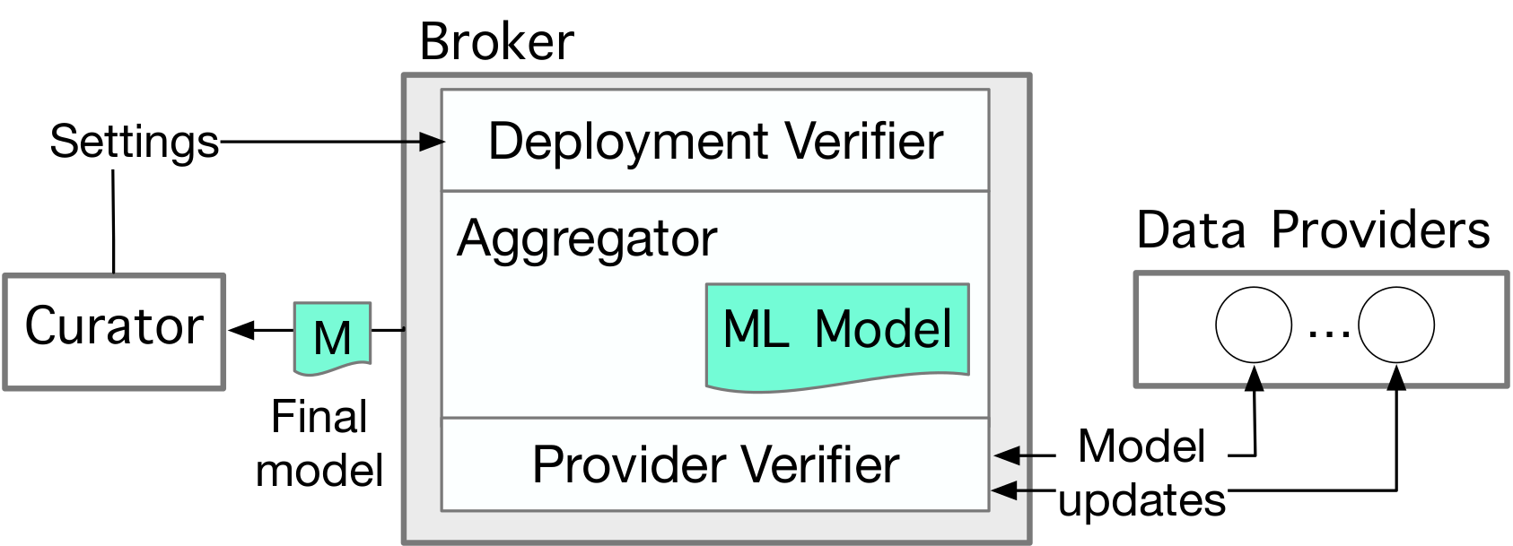
Threat model
Assume:
Broker honours verifier parameters
Users adhere to the given APIs for joining and model updates
Curators and data providers can collaborate
Trust is based on incentives: broker is neutral to ML incentive trade-off
If broker attacks clients or violates curator specifications, reputation lost
Governments, large organizations, blockchains

Slide 32
TorMentor : An Example Brokered Learning System

Slide 33
TorMentor system goals
Use brokered learning to build the first anonymous ML system:
Further support privacy in multi-party ML
Data provider and curator identity are hidden:
From each other and from the broker
Meet defined learning objectives in reasonable time
Compared to WAN federated learning baseline

Slide 34
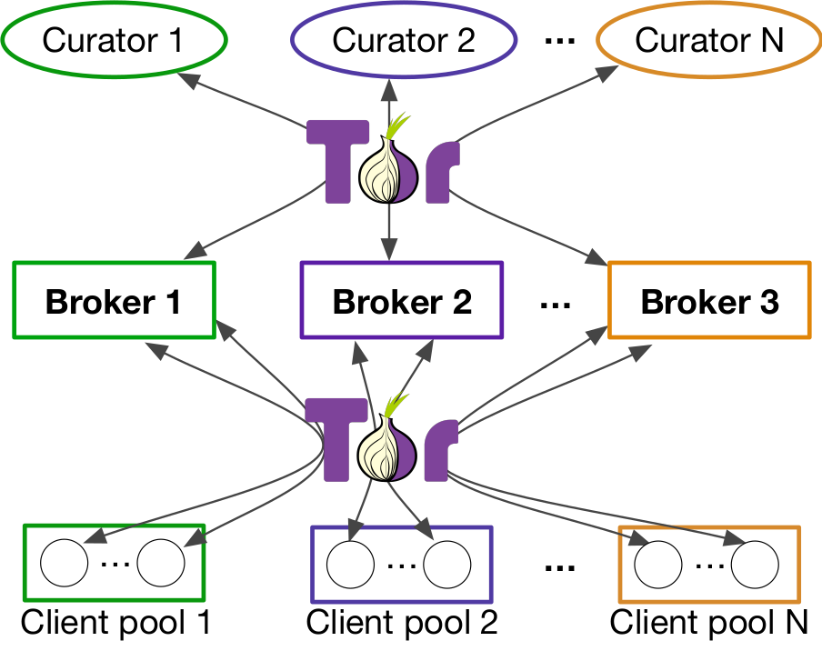
Implementation on Tor
Onion routing protocols (Tor) [1]
Hide source and destination of messages by communicating through chain of random nodes in system
Hide identity of users in distributed ML!
Deploy broker as hidden Tor service
[1] Dingledine et al. “Tor: The Second-Generation Onion Router” Usenix Security 2014.

Slide 35
Implementation
Libraries written in Python and Go
1500 LOC Python, 600 LOC Go
Tested on “credit card default” UCI dataset
Logistic classifier
30000 examples, 24 features (14 MB / client)
Deployment at scale on Azure (8 data centres)
Deploy curators and data providers as users over wide area network

Slide 36
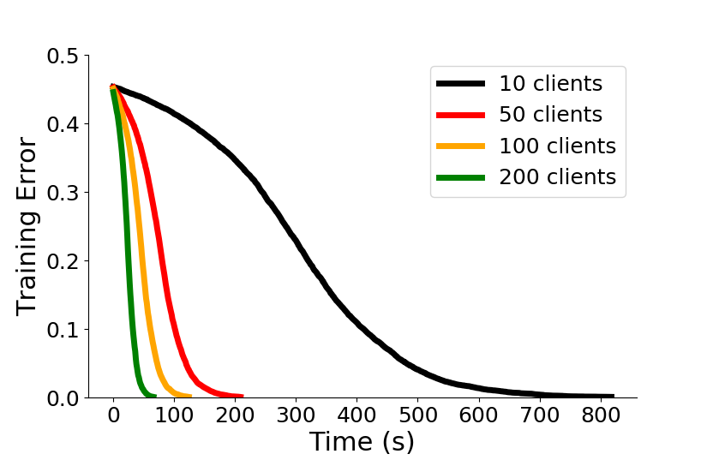
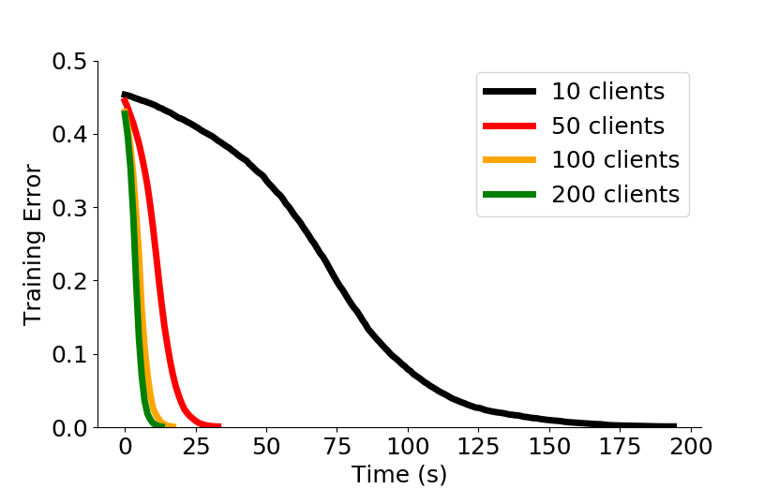
Convergence at scale over Tor
With Tor
Without Tor

Slide 37
Convergence at scale over Tor
With Tor
Without Tor
TorMentor is within 4-10x baseline, and still converges while serving 200 clients on a WAN.

Slide 38
Provider verifier
Reject on Negative Influence (RONI) [1]
Reject datasets with negative impact on “influence” metric
Typically, just use validation error
Model curator defines a distributed RONI:
Evaluate influence of model updates instead of data
Use curator provided validation set
Tune using data provider proof-of-work [2]
[1] Barreno et al. “The Security of Machine Learning.” Machine Learning 81:2, 2010.
[2] Nakamoto, Satoshi. “Bitcoin: A peer-to-peer electronic cash system” 2008.

Slide 39
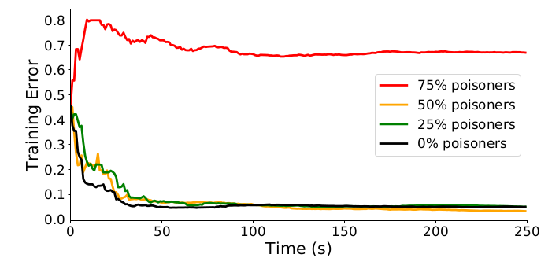
Evaluation: Provider verifier
Notes:
RONI 0.02

Slide 40
Evaluation: Provider verifier
The curator can define a service through the broker that rejects attacks under certain conditions.
Notes:
RONI 0.02

Slide 41


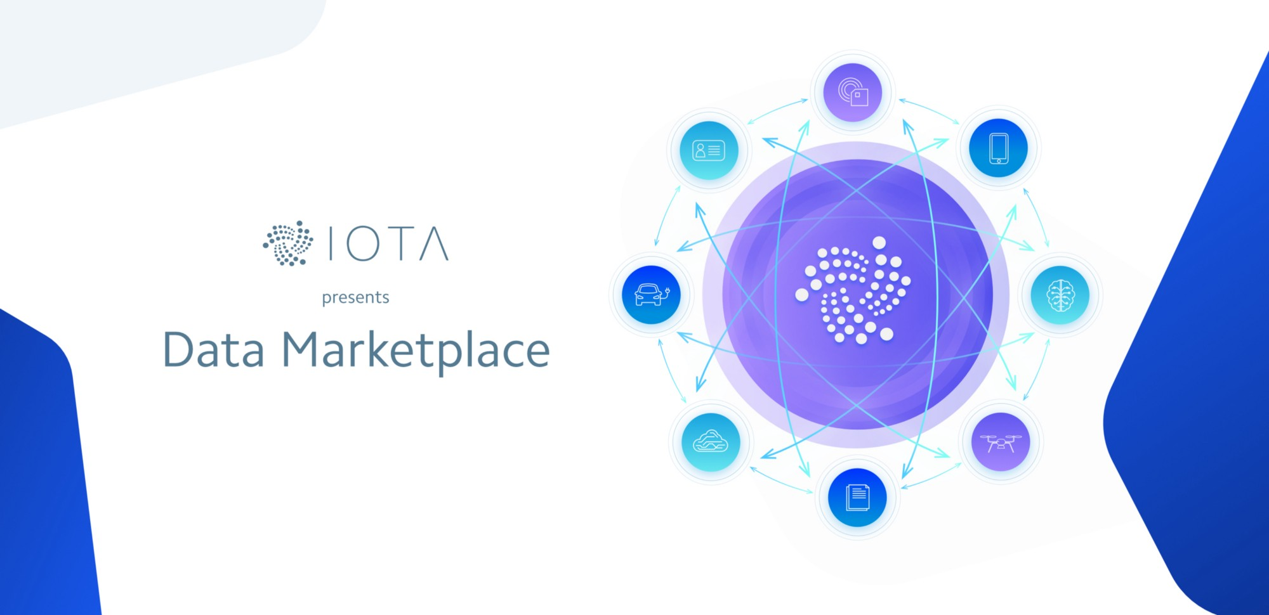
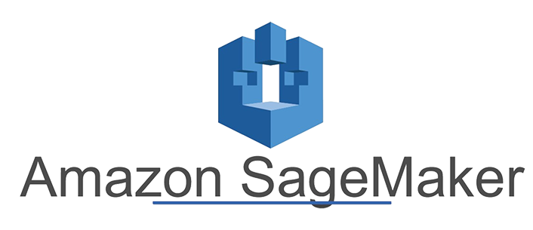

Brokered learning opportunities and limitations
Modern use cases:
Blockchain-based data marketplaces
Standardizing “ML as a service”
GDPR Compliance
Limitations
Moving from 2 actors to 3
Adoption from big players
Notes:
Modern use cases:
Blockchain based data marketplaces
Standardizing “ML as a service”
GDPR compliance
Limitations
Performance: from 2 actors to 3

Slide 42
Summary of contributions
Existing ML systems do not provide:
Incentives, privacy, security
We propose brokered learning as an alternative to federated learning
APIs to protect process from model owners and data providers
TorMentor prototype
Supports anonymous ML between data providers and curators
Allows curator defined process to reject malicious data providers
https://github.com/DistributedML/TorML

